Slide 1

HR PAYROLL AUTOMATION USING ROBOTIC PROCESS AUTOMATION (RPA)
PROJECT SUPERVISOR:- DR.MALINI DEEPIKA
Submitted by – MD.TANVEER HASAN ANSARI
Register no. - 39110614

Slide 2
COURSE CERTIFICATE
.

Slide 3
INTRODUCTION
• Payroll is a list of Employees who get paid by the company. Payroll also refers to the total amount of money employer pays to the Employees.
• Robotic Process Automation (RPA) is a type of automation technology currently transforming the way businesses operate.
Excel automation streamlines your use of the application by automatically performing tasks.
• Managers today must make better and faster business decisions than ever. Investments which are focusing on information technology are often considered as a critical method of speeding up and improving the management decision making. Yet it has proved distressingly difficult to understand the actual potential of investments in Information Technology. This is particularly common in business areas focusing on Human Resources (HR).

Slide 4
.
In almost every organization, the responsibility of performing various strategic tasks such as management of the recruitment process, termination process, payroll management etc. lies within the Human resource department.
Some of it may include Employee_ monitoring at different levels, payroll management, Employee_ benefits, training, and development, etc. In-order to make this work a lot easier, organizations across the world are investing in HR automation in-order to find out and perform the best human capital decision.
However, every organization are now looking for more advanced methods of automation, which may help them to manage various complex processes such as, Data storage, Data control and modifications, Effective communication process enhancement, better connectivity with all departments easily and swiftly which would also be useful for the long-term goals of the organization.
Information Technology has now considered as a potential tool that managers use, both generally, and in human resource functions, to increase the capabilities of the organization.

Slide 5
OBJECTIVES
● Gain insights into building blocks of Blue Prism automation.
● Importing MS Excel VBO (Visual Basic for Applications) in Blue Prism.
● Tuning Process Studio with specific needs.
● Working with different stages in the Process studio.
● Build a HR Payroll Excel Automation that works over Microsoft excel.

Slide 6
PURPOSE
Manage Employee Information Efficiently.
Define the emoluments, deductions, leave etc.
Generate and Manage the Payroll Processes according to the Salary structure assigned to the Employee.
Generate all the Reports related to Employee, attendance/leave, payroll etc.
• Manage your own Security.

Slide 7
Features of Proposed System
A sophisticated payroll calculation algorithm.
Error prevention
Reporting and statistics
• Attendance
• Leave and attendance management
• Faculty Management
• Overtime Calculation
• Send salary slips through mail
• HRD modules like offer letter, appointment letter, promotion letter etc.
• Generate annual profit-loss of organization Advantages

Slide 8
REQUIREMENTS
Pre-requirements for Blue Prism
• Creates and supports a digital workforce of industrial strength and enterprise
scale.
• Does not require IT skills to implement
• Can be implemented in sprints of 4 to 8 weeks (Start to finish)
• Is very low cost compared to the TCO of alternative solutions
• Provides tremendous payback with self-funding returns and an ROI that has been as high as 80%
• Can be managed within IT infrastructure and processes

Slide 9
Installation of Blue Prism
The following are the installation requirements for Blue Prism –
• Windows 10 (Preferred) OS, 64 bit
• Blue prism installation Software, 64 bit
• Blue Prism License File
• SQL Server Express Edition, 64

Slide 10
Software Requirements
• Operating system: Windows XP/Vista or any main stream OS
• Installation and Setup Guide for Blue Prism
• Installation and Setup Guide for MS Excel
• Blue prism Version: 6.10.1
• Blue prism License File
• Blue prism installation Software 64 bit
• MS Excel
• Windows 7/8/10

Slide 11
Hardware Requirements
• Internet connection to download and activate
• Administration access to install and run Blue Prism
• Minimum 10GB free disk space
• Windows 8.1 or 10.
Minimum System Requirements to run Office Excel 2013, your computer needs to meet the following minimum hardware requirements:
* 500 megahertz (MHz)
* 256 megabytes (MB) RAM
* 1.5 gigabytes (GB) available space
* 1024x768 or higher resolution monitor

Slide 12
Project Flow
● Importing Blue Prism MS Excel VBO (Visual Basic for Applications)
● Binding Process Studio with MS Excel VBO.
● Opening MS Excel Workbook.
● Specifying Blue Prism Stages to work on MS Excel Workbook in Blue Prism.
● Tuning Process Flow with Blue Prism Actions.
● Closing MS Excel Workbook.

Slide 13

FLOW AND IMPLEMENTATION
Idea:
Need to find a new one --“Generally, in the industries monitoring the machine status continuously and maintaining the records of the entire data plays a very important role as that helps the officials to analyze the production factors. This also helps in resolving some of the problems like machine failures, production delays, etc.

Slide 14
ACTIVITIES
Milestone 1: Configure the Process Studio
Let us create the Process Object bind with MS Excel VBO.
Object studio is mainly used to develop the objects. Inside the object, we have different types of actions as follows:
1. Application Modular to Spy the Elements
2. Initialize page and clean up page.

Slide 15
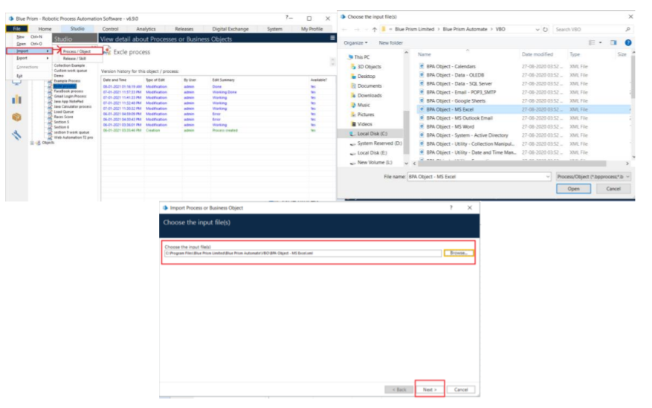
Activity 1: MS Excel VBO (Import VBO file)
File -> Import -> Browse -> (C:\Program Files\Blue Prism Limited\Blue Prism Automate\VBO\BPA Object-MS Excel). Click Finish.

Slide 16
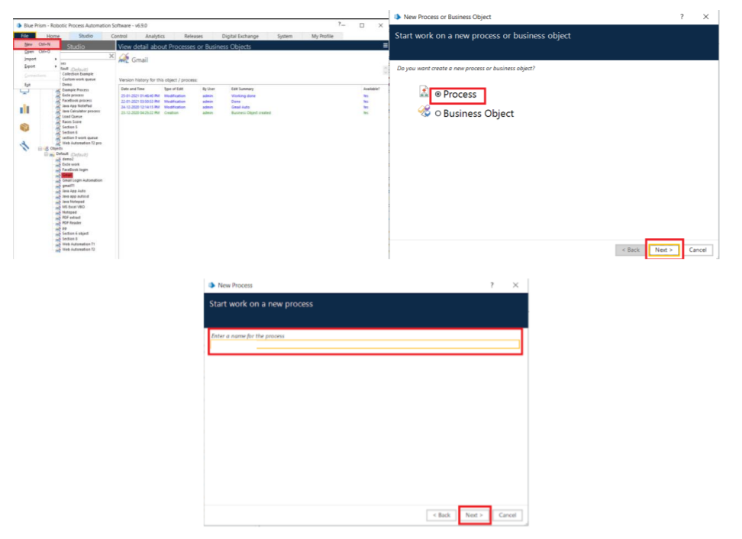
Activity 2: Creating the Process Object from Object Studio
Process studio has only the Main page. We can call from the process studio. We use the Process studio for developing and testing.

Slide 17
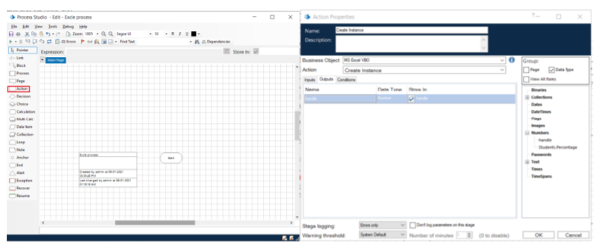
Open Created Process Model (HR Payroll Process)

Slide 18
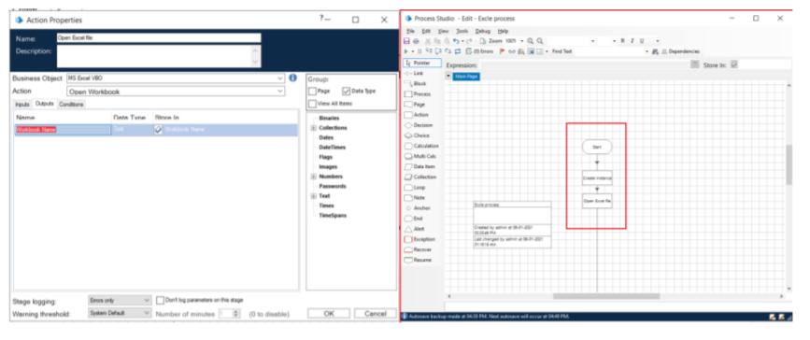
1. Create Action Stage as “Create Instance” (Business Object = MS Excel VBO; Action = Create Instance).
a. Click on the Outputs tab
I. Create Data Item, type = number, name = “handle”. Drag it into the store in column.
II. Click on ok.

Slide 19
2. Create Action Stage as “Open Excel file” (Business Object = MS Excel VBO; Action = Open Workbook).
a. Click on the Inputs tab
i. Drag “handle” data item into handle Value column.
ii. Set file path of excel file in File Name Value column

Slide 20
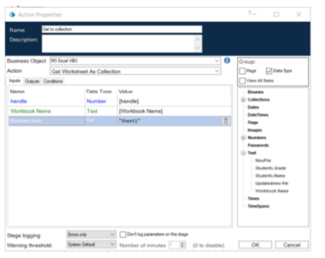
3. Create Action as “Get to collection” (Business Object = MS Excel VBO; Action = Get Workbook As Collection).
a. Click on the Inputs tab
i. Drag “handle” data item into handle Value column.
ii. Drag “Workbook Name” data item into the Workbook Name Value column
iii. Write Worksheet name as “Sheet1”.

Slide 21
4. Drag Loop module, Drag Multi Calculation module. Connect loop start with Multi Calc stage. Open Multi Calculation Properties and create the following fields.
a. [Employee__.SAL RATE BASIC]*0.1
b. ([Employee__.SAL RATE BASIC+Employee__.SAL RATE DA])*0.3
c. [Employee__.SAL RATE BASIC+Employee__.SAL RATE DA+Employee__.SAL RATE HRA]
d. [Employee__.ATTEND P]+[Employee__.ATTEND PL]+[Employee__.ATTEND WO]
e. ([Employee__.SAL RATE BASIC]*[Employee__.ATTEND PD])/31
f. ([Employee__.SAL RATE DA]*[Employee__.ATTEND PD])/31
g. ([Employee_.SAL RATE HRA]*[Employee_.ATTEND PD])/3
h. [Employee_.GROSS BASIC]+ [Employee_.GROSS DA]+ [Employee_.GROSS HRA]+ [Employee_.INCENTIVE]
i. [Employee_.TOTAL GROSS]*0.0075
j. ([Employee_.GROSS BASIC]+ [Employee_.GROSS DA])*0.12
k. [Employee_.ESI AMT]+[Employee_.PF AMT]+[Employee_.TDS]+[Employee_.PT]
l. [Employee_.TOTAL GROSS]-[Employee_.TOT DED]

Slide 22
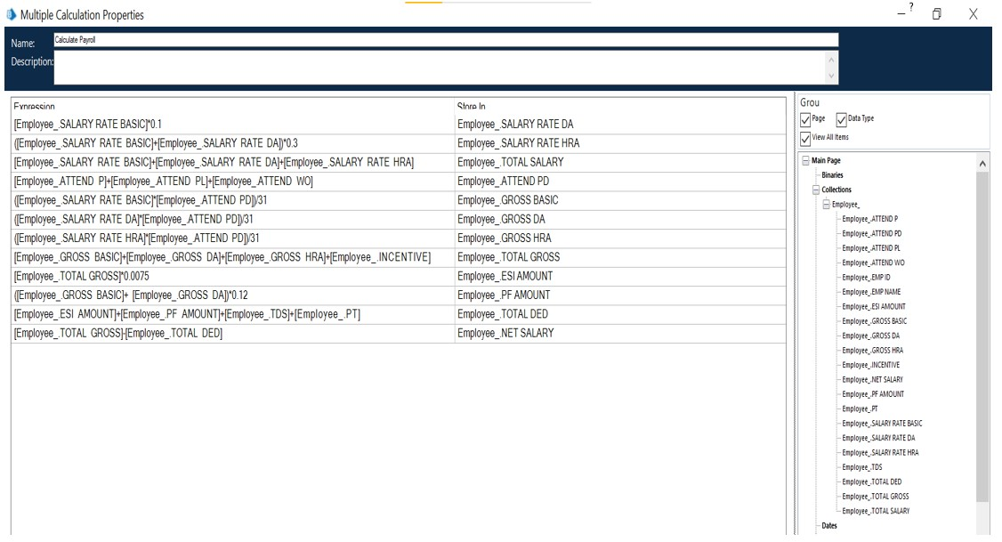

Slide 23
5. Create Action Stage as “Write collection” (Business Object = MS Excel VBO; Action = Write Collection).
a. Click on the Inputs tab
i. Drag “handle” data item into handle Value column.
ii. Drag “Workbook Name” data item into the Workbook Name Value
column.
iii. Drag “Employee” Collection into the Collection Value column.
iv. Write Worksheet name as “Sheet1”.
v. Write Cell Reference as “A1”.
vi. Set Include Column Names as True

Slide 24
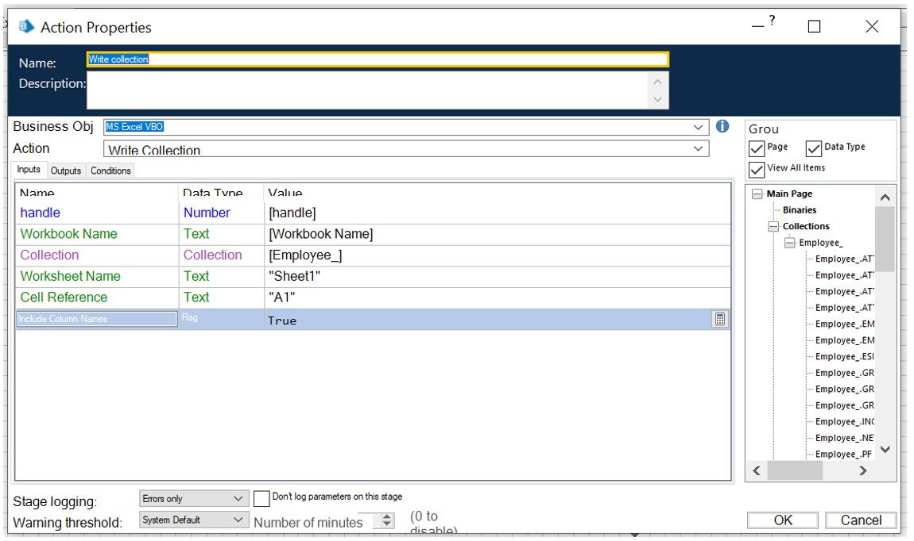

Slide 25
6. Create Action Stage as “Save Excel file” (Business Object = MS Excel VBO; Action = Save Workbook).
a. Click on the Inputs tab.
i. Drag “handle” data item into handle Value column.
ii. Drag “Workbook Name” data item into the Workbook Name Value column.
7. Create Action Stage as “Close workbook” (Business Object = MS Excel VBO; Action = Close Current Workbook).
a. Click on the Inputs tab
b. Drag “handle” data item into handle Value column
c. Do connections as follows.

Slide 26
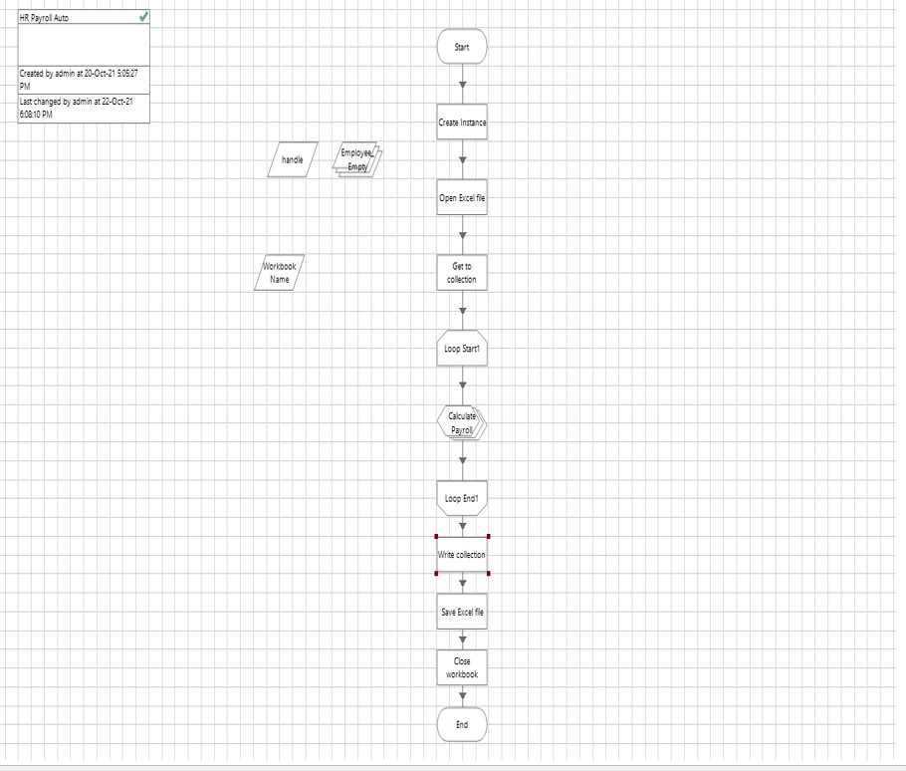

Slide 27
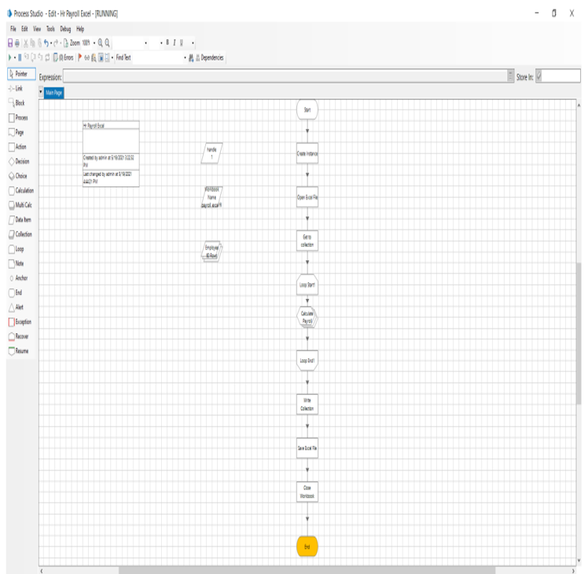
Activity 3: Testing the Process Object from Object Studio
Click on the Main Page, click on the Green play button to run the ‘Excel Process’ Process object. It shows COMPLETED when there is no error or no failure in the object.
Click on the Main Page, click on the Reset button to reset the cache for rerun the process object as fresh.

Slide 28
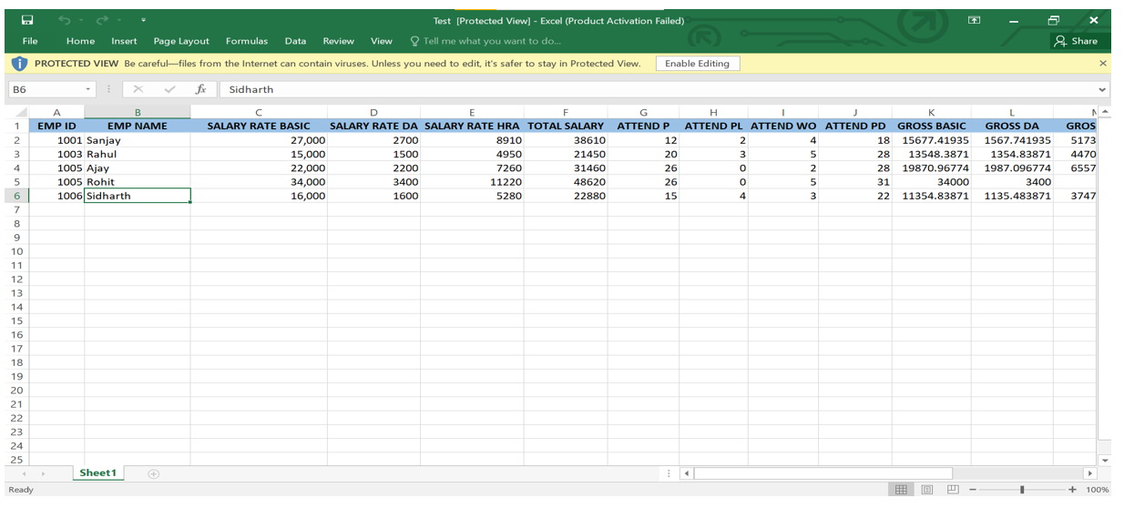
Output Excel file

Slide 29
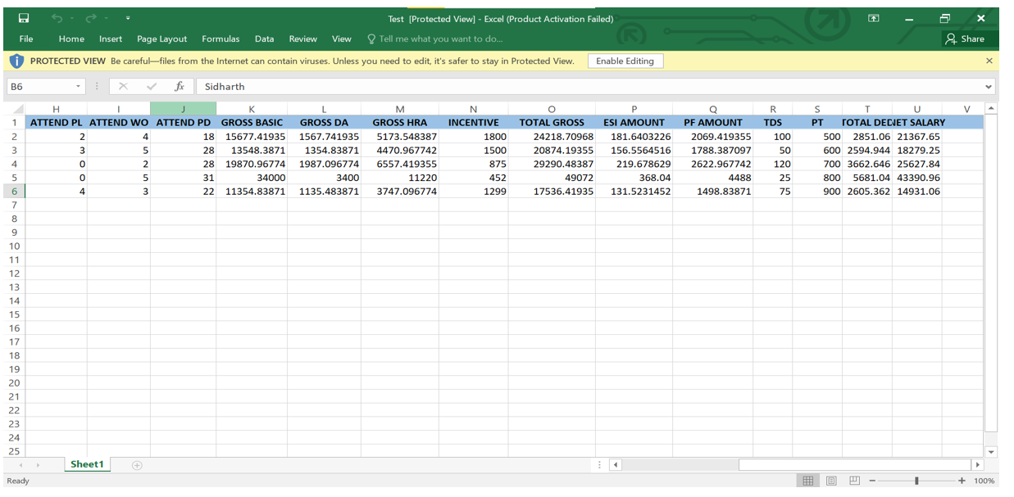

Slide 30
CONCLUSION
The discussion of the effects of HR Automation perceived buy the employees regarding both individual as well as organizational perspective, presented in this Study is far from comprehensive. HR automation influences people, organizations, and societies in innumerable other ways. Perhaps we can identify some unique effects that Information Technology has on the way we live, learn, work, and play. Nevertheless, the variables studied in this research are sufficient to recognize that the changes caused by HR automation introduce a variety of new issues for individuals and Organizations and radically alter the importance of certain preexisting cultures and practices. Each technology is likely to affect multiple groups of people, whether directly or indirectly. Moreover, the effects of any given technology are rarely only beneficial or only detrimental; they typically create a complex web of consequences that may be both positive and negative. This study and the entire research reveal that evolution of HR process automation is not happening in a vacuum.

Slide 31
Recurring Payroll Services:
• Gross pay calculation (basic salary, wage supplements, occasional payments, cost reimbursements)
• Calculation of payroll related taxes and contributions.
• Recording and processing of garnishments and other deductions.
• Preparation of payroll slips and other outputs broken down by employees or by cost centers for managerial and operational use.
Data recording and processing in connection with voluntary pension and health insurance funds, reporting to the pension funds.
• Recording of wage and labor-related data (registration of personnel information, holiday and sick leave balances).
• Providing data and information for posting into the General Ledger.
• Data reports and certificates related to payroll processing (to the tax and social security authorities, the Statistical Office, etc.).
• Full range of Social Insurance management
• Tasks related to new comers and departing employees
• Annual services connected to payroll processing and social security administration
• Preparation and submission of tax declarations

Slide 32
FUTURE ENHANCEMENTS
This salary management program can be further enhanced by a budget program in future. In budget program every team leader will have support to manage and utilize specific amount of money in an efficient way with this amount he will manage everything like college expenditures etc. The prototype automated payroll system is complete in itself and ready to be implemented but changes and growth in requirements will be a reality on every software project so there is need to timely update them. The same applies to this payroll system. There is always room for improvement, and the software we created can also be improved. This is especially because we had to create it within a limited time. With more time, the software can be improved to include security and different types of users. This would be the first step in making the software network-enabled, and eventually web-enabled. This was our original afterthought to programming the software, and we had chosen Blue Prism. In addition, the software can also be improved in terms of the calculations it can do, and more flexibility in the rates used in calculations per employee.

Slide 33
BIBLIOGRAPHY AND REFERENCES
1. Ball KS. The use of human resource information systems: a survey. Personnel review. 2001; 30(6):677-693.
2. Beadles II, Aston N, Lowery CM, Johns K. The impact of human resource information systems: An exploratory study in the public sector. Communications of the IIMA. 2005; 5(4):6.
3. Bell BS, Lee SW, Yeung SK. The impact of e‐ HR on professional competence in HRM: Implications for the development of HR professionals. Human Resource Management. 2006; 45(3):295-308.
4. Broderick R, Boudreau JW. Human resource management, information technology, and the competitive edge. The Executive. 1992; 6(2):7-17.
5. Fernández-Sánchez JA, de Juana-Espinosa S, Valdés Conca, j. use of HRIS in recruitment process.
https://ijmter.com/papers/volume-3/issue-2/automated-payroll-system.pdf
https://aip.scitation.org/doi/pdf/10.1063/1.5055526 https://ijarcce.com/wp-content/uploads/2015/02/IJARCCE1M.pdf http://www.ijrdt.org/upload/717858- Survey%20On%20Various%20Automated%20Payroll%20System.pdf
https://www.giac.org/paper/gsec/1392/automated-human-resources-payroll-hrpayroll-systemsecurity-test-plan/102607
https://silo.tips/download/software-testing-process-using-a-payroll-system-as-a-case-study
https://www.slideshare.net/ShubhamModi5/payroll-management-system-srs

